Slide 1


Foundations of
Scientific Computing
(SciComp 101)
Dave Biersach
dbiersach@bnl.gov
Session 07 Probability and Statistics

Slide 2
Session 07 – Goals
Analyze Hero ability scores in role-playing games by calculating the mean, variance, and standard deviation of a sequence of random numbers
Write code to "manually" calculate the mean, median, and mode of an array of random numbers
Develop a computational mathematics experiment that uncovers a magic number hidden in all uniform random number distributions
Investigate if a Normal Distribution can be generated from a Uniform Distribution using a Pachinko game
Estimate the number of lattice points in a circle

Slide 3

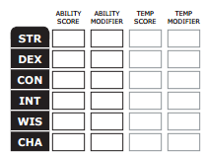
Generating Hero Ability Values
In most role-playing games, heroes have abilities such as strength, dexterity, intelligence, charism, etc.
Initial abilities are often measured in ranges like 3 – 18
At the beginning of the game, players roll dice to determine the initial values for each ability
The higher the value, the more likely the player will succeed while adventuring

Slide 4
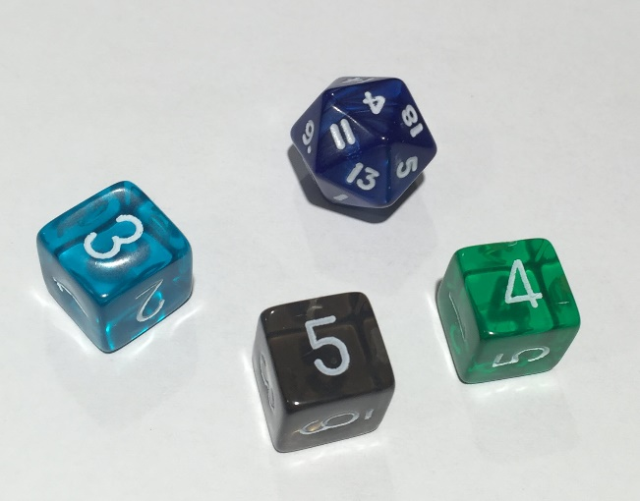
Generating Hero Ability Values
Two ways of rolling for initial abilities between 3 and 18
Roll a 20-sided die just once (1d20), but reroll if face value is 1, 2, 19, or 20
Roll a 6-sided die three times (3d6), summing the value of each roll
Using the 1d20 method is faster than 3d6, especially when having to roll for six separate abilities
17
11
15
5
7
3

Slide 5
Generating Hero Ability Values
Two ways of rolling for initial abilities between 3 and 18
Roll a 20-sided die just once (1d20), but reroll if face value is 1, 2, 19, or 20
Roll a 6-sided die three times (3d6), summing the value of each roll
Which method would you want to use? Why?
17
11
15
5
7
3

Slide 6
Mean vs. Variance
Imagine two different classes take the same test
1st period students score between 50 and 100 with μ = 75
2nd period students score between 70 and 80 with μ = 75
Variance ${(σ}^{2})$ is the average “distance” between each number in a set and the mean $\left(μ\right)$ of that set
1st period students have a greater variance in scores than 2nd period
Variance is a measure of central tendency – on average how close around the mean do all the numbers fall?
For every data point, we sum the square of the difference between the number and the mean. Then we divide that sum by the total number of data points

Slide 7
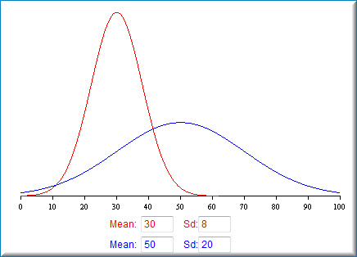
Mean vs. Standard Deviation
Note: Standard Deviation (σ) is the square root of the Variance (σ²)

Slide 8
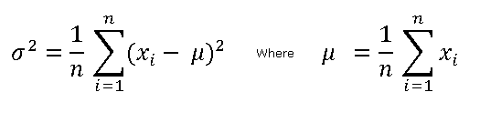
Mean, Variance, Standard Deviation
Mean
$$x=\left\{2, 9, 11, 5, 6\right\}∴n=5$$
$$\sum_{i=1}^{n}{x_{i}}=\left(2+9+11+5+6\right)=33$$
$$μ=\frac{33}{5}=6.6$$

Slide 9
Mean, Variance, Standard Deviation
Variance
Mean
$$x=\left\{2, 9, 11, 5, 6\right\}∴n=5, μ=6.6$$
$$\sum_{i=1}^{n}{{{(x}_{i}−μ)}^{2}}={(2−6.6)}^{2}+{(9−6.6)}^{2}+{(11−6.6)}^{2}+…=49.2$$
$$σ^{2}=\frac{49.2}{5}=9.84$$

Slide 10

Mean, Variance, Standard Deviation
Variance
Mean
$$x=\{2, 9, 11, 5, 6\}$$
Standard Deviation
$$σ^{2}=9.84$$
$$σ=\sqrt{9.84}≅3.13$$

Slide 11
Determine Which Roll Method is Best
Write a program to generate 1,000,000 hero ability scores, comparing the mean and standard deviation of the 1d20 versus the 3d6 dice roll methods
Which dice roll method would you want to use to generate your hero’s abilities – and why?

Slide 12
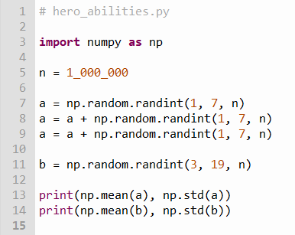
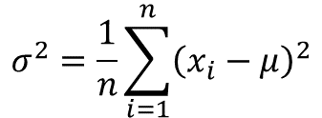
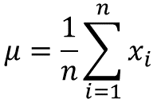
Edit hero_abilities.py
①
②
③
④
⑤
⑥
$$μ=\frac{1}{n}\sum_{i=1}^{n}{x_{i}}$$
$$σ^{2}=\frac{1}{n}\sum_{i=1}^{n}{{\left(x_{i}−μ\right)}^{2}}$$

Slide 13





Run hero_abilities.py
$$μ 3d6$$
$$σ 3d6$$
$μ 1d2$0
$σ 1d2$0
Which roll type will most likely give you the highest average score across all abilities?

Slide 14
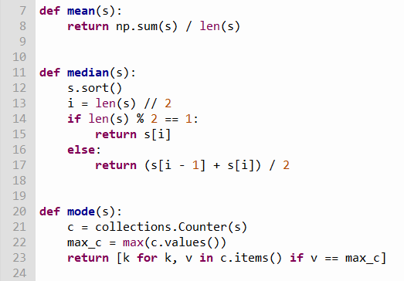
Open common_statistics.py
①
Note: You should not edit this file!
②
③
④
⑤
⑥
⑦
⑧
⑨
⑩

Slide 15
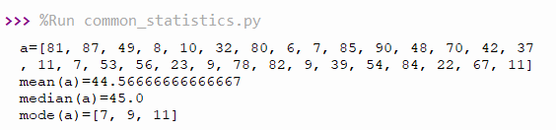
Run common_statistics.py
①
②
③
Your numbers will not match these and you will get different numbers every time you run the program because we generate a random array

Slide 16
Variance of Uniform Distributions
Your scientist needs a program that can:
Generate 15 sets of random sizes between 10,000 and 200,000 items
Within each set, every item is a random integer chosen within a range between a random lower limit and a random upper limit
The lower limit for each set is a random number between 0 and 10,000
The upper limit is that set’s lower limit plus another random number between 0 and 100,000
Calculate the mean (μ) and variance (σ²) for each set's population
$$σ^{2}=\frac{1}{n}\sum_{i=i}^{n}{{\left(x_{i}−μ\right)}^{2} where μ=\frac{1}{n}\sum_{i=1}^{n}{x_{i}}}$$

Slide 17
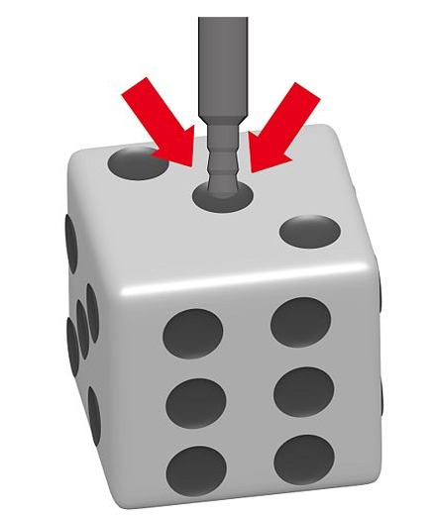
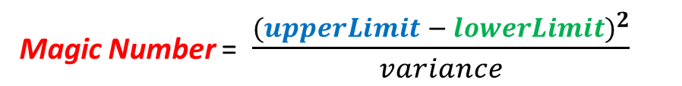
Variance of Uniform Distributions
The research goal is to determine if a magic number hides within all uniform random number distributions
Calculate and display this “constant” for each set:
Is this number the same for ALL uniform distributions?
Can we use this value to test if dice are loaded?
Magic Number = $\frac{{(upperLimit − lowerLimit)}^{2}}{variance}$

Slide 18
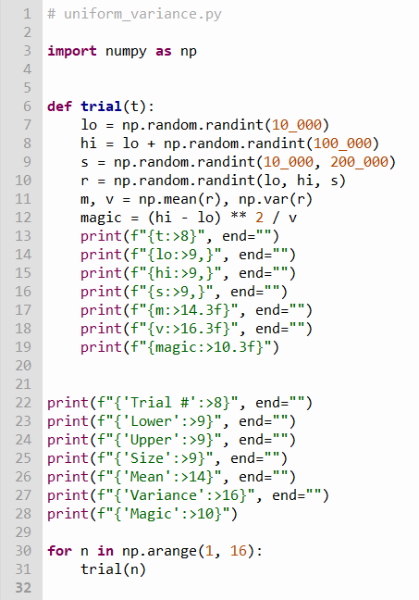
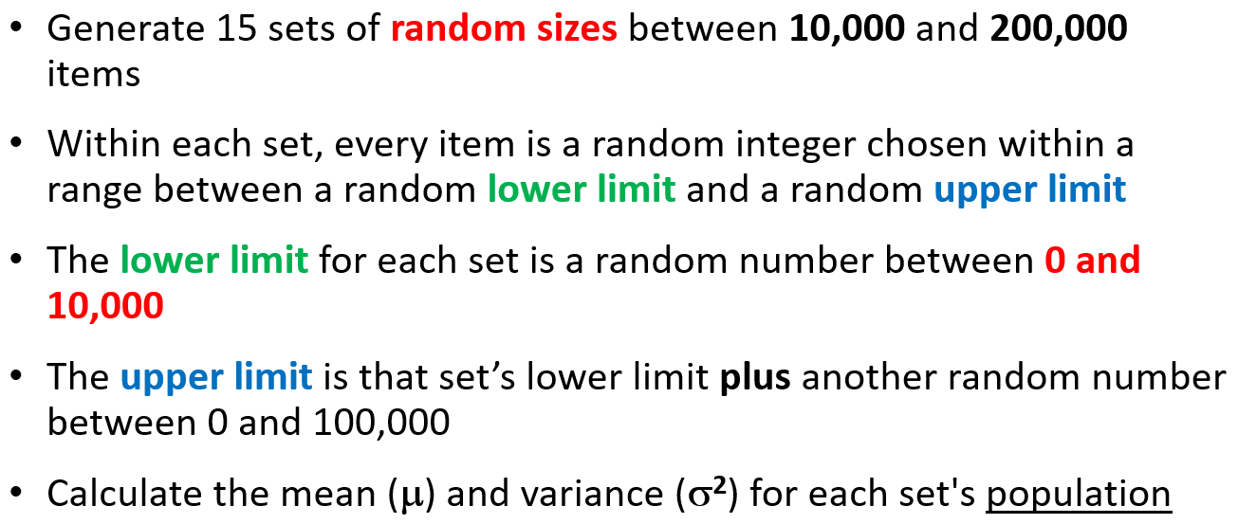
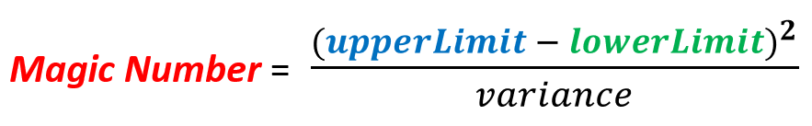
Open uniform_variance.py
③
④
Note: You should not edit this file!
⑤
⑥
⑦
⑧
⑨
✓
✓
✓
✓
✓
✓
✓
①
②

Slide 19
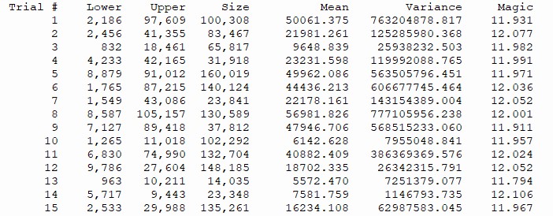
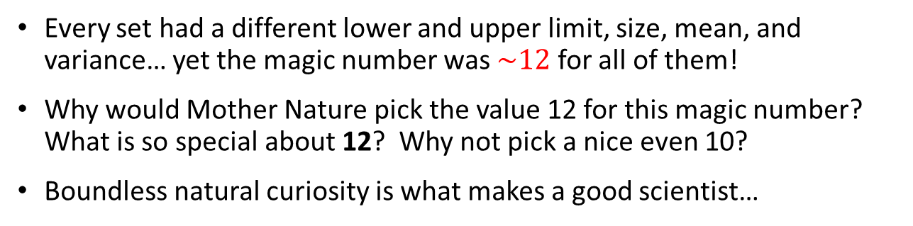
Run uniform_variance.py
Every set had a different lower and upper limit, size, mean, and variance… yet the magic number was $\sim 12$ for all of them!
Why would Mother Nature pick the value 12 for this magic number? What is so special about 12? Why not pick a nice even 10?
Boundless natural curiosity is what makes a good scientist…

Slide 20

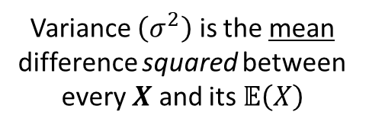
Variance of Uniform Distributions
$$σ^{2}=\frac{1}{n}\sum_{i=i}^{n}{{\left(x_{i}−μ\right)}^{2} where μ=\frac{1}{n}\sum_{i=1}^{n}{x_{i}}}$$
The expected value $\left(𝔼\right)$
of a random variable $X$ is its mean value $\left(μ\right)$
Variance $\left(σ^{2}\right)$ is the mean difference squared between every $X$ and its $𝔼\left(X\right)$
$$𝔼\left(X\right)=μ=\frac{1}{n}\sum_{i=1}^{n}{x_{i}}$$
$σ^{2}=𝔼$ $\left[{\left(X−𝔼\left(X\right)\right)}^{2}\right]$
The expected value $\left(𝔼\right)$
returns a constant value
$$𝔼\left(X\right)=μ$$
$$𝔼\left(𝔼\left(X\right)\right)=𝔼\left(X\right)$$
The expected value $\left(𝔼\right)$
of a constant value returns that same value
$$𝔼\left(𝔼\left(𝔼\left(X\right)\right)\right)=𝔼\left(X\right)$$
$$𝔼\left(μ\right)=μ$$
$𝔼\left(X\right)$ is idempotent

Slide 21

Variance of Uniform Distributions
$$σ^{2}=\frac{1}{n}\sum_{i=i}^{n}{{\left(x_{i}−μ\right)}^{2} where μ=\frac{1}{n}\sum_{i=1}^{n}{x_{i}}}$$
$$μ=𝔼\left(X\right)=\frac{1}{n}\sum_{i=1}^{n}{x_{i}}$$
$σ^{2}=𝔼$ $\left[{\left(X−𝔼\left(X\right)\right)}^{2}\right]$
FOIL
$$σ^{2}=𝔼\left[X^{2}−2X𝔼\left(X\right)+{𝔼\left(X\right)}^{2}\right]$$
$σ^{2}=𝔼$ $\left[{\left(X−𝔼\left(X\right)\right)}^{2}\right]$
Note: $𝔼\left(x\right)$ is a distributive linear operator
$$𝔼\left(μ\right)=μ$$
$$σ^{2}=𝔼\left(X^{2}\right)−𝔼\left(2X𝔼\left(X\right)\right)+𝔼\left({𝔼\left(X\right)}^{2}\right)$$
$$𝔼\left(𝔼\left(X\right)\right)=𝔼\left(X\right)$$
$$σ^{2}=𝔼\left(X^{2}\right)−2𝔼\left(X\right)𝔼\left(X\right)+{𝔼\left(X\right)}^{2}$$
Faster because
only one subtraction is required!
$$σ^{2}=\left(\frac{1}{n}\sum_{i=1}^{n}{x_{i}^{2}}\right)−μ^{2}$$
$$σ^{2}=𝔼\left(X^{2}\right)−2{𝔼\left(X\right)}^{2}+{𝔼\left(X\right)}^{2}$$
$$σ^{2}=𝔼\left(X^{2}\right)−{𝔼\left(X\right)}^{2}$$
$$σ^{2}=𝔼\left(X^{2}\right)−μ^{2}$$

Slide 22
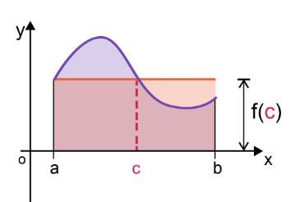

Variance of Uniform Distributions
$f\left(c\right)=$ the average value of the function
Mean Value Theorem (Integrals)
$${Area}_{red}={Area}_{curve}$$
$$f\left(x\right)=f\left(c\right)$$
$$when x=c$$
$${Area}_{red}=f(c)×\left(b−a\right)$$
$${Area}_{curve}=\int_{a}^{b}{f\left(x\right)ⅆx}$$
$$f\left(c\right)×\left(b−a\right)=\int_{a}^{b}{f\left(x\right)ⅆx}$$
Random Variable (Uniform Distribution)
$$𝔼\left(X\right)=\frac{1}{n}\sum_{i=1}^{n}{x_{i}}$$
$$f\left(c\right)=\frac{1}{\left(b−a\right)}\int_{a}^{b}{f\left(x\right)ⅆx}$$
Discrete:
$$𝔼\left(X\right)=\frac{1}{\left(b−a\right)}\int_{a}^{b}{xⅆx}$$
$$f\left(c\right)=μ=𝔼\left(X\right)$$
Continuous:

Slide 23
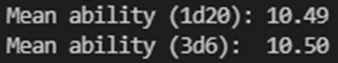
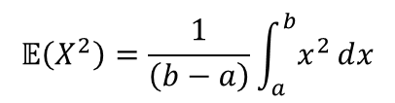
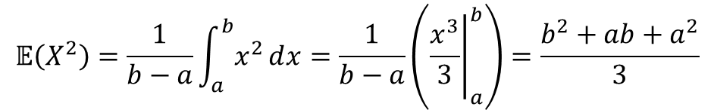
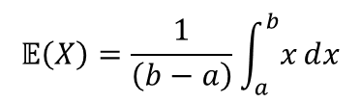
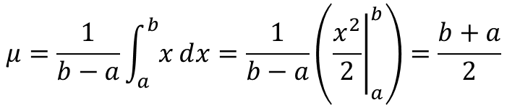


Variance of Uniform Distributions
$$𝔼\left(X\right)=\frac{1}{\left(b−a\right)}\int_{a}^{b}{xⅆx}$$
Moment Generating Function
$$𝔼\left(X^{2}\right)=\frac{1}{\left(b−a\right)}\int_{a}^{b}{x^{2}ⅆx}$$
$$σ^{2}=𝔼\left(X^{2}\right)−μ^{2}$$
$$μ=\frac{1}{b−a}\int_{a}^{b}{xⅆx}=\frac{1}{b−a}\left({\left.\frac{x^{2}}{2}\right|}_{a}^{b}\right)=\frac{b+a}{2}$$
Hero Ability Results
$$𝔼\left(X^{2}\right)=\frac{1}{b−a}\int_{a}^{b}{x^{2}ⅆx}=\frac{1}{b−a}\left({\left.\frac{x^{3}}{3}\right|}_{a}^{b}\right)=\frac{b^{2}+ab+a^{2}}{3}$$
$$\frac{\left(18+3\right)}{2}=10.5$$

Slide 24
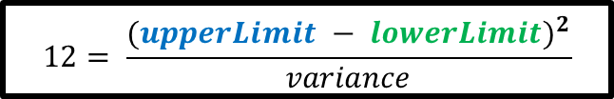
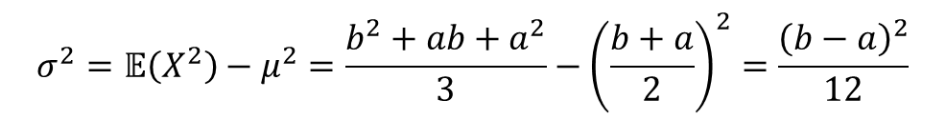
Variance of Uniform Distributions
$$𝔼\left(X\right)=\frac{1}{\left(b−a\right)}\int_{a}^{b}{xⅆx}$$
Moment Generating Function
$$𝔼\left(X^{2}\right)=\frac{1}{\left(b−a\right)}\int_{a}^{b}{x^{2}ⅆx}$$
$$12= \frac{{(upperLimit − lowerLimit)}^{2}}{variance}$$
$$σ^{2}=𝔼\left(X^{2}\right)−μ^{2}$$
$$μ=\frac{1}{b−a}\int_{a}^{b}{xⅆx}=\frac{1}{b−a}\left({\left.\frac{x^{2}}{2}\right|}_{a}^{b}\right)=\frac{b+a}{2}$$
This is the second central moment of a uniform distribution
$$𝔼\left(X^{2}\right)=\frac{1}{b−a}\int_{a}^{b}{x^{2}ⅆx}=\frac{1}{b−a}\left({\left.\frac{x^{3}}{3}\right|}_{a}^{b}\right)=\frac{b^{2}+ab+a^{2}}{3}$$
$$σ^{2}=𝔼\left(X^{2}\right)−μ^{2}=\frac{b^{2}+ab+a^{2}}{3}−{\left(\frac{b+a}{2}\right)}^{2}=\frac{{\left(b−a\right)}^{2}}{12}$$

Slide 25
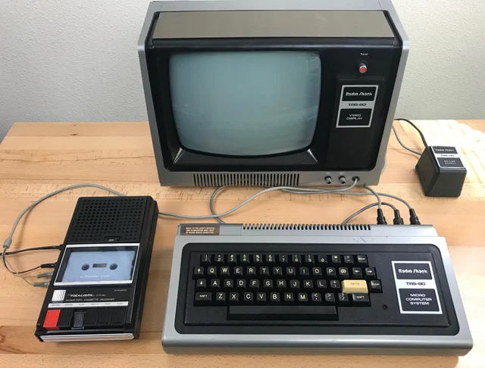
Simulating a Normal Distribution
Until recently, most computer languages only provided a uniform pseudo-random number generator
Growing up I had heard of a bell curve, and I understood the rationale for curving test scores
However, I could not create a Normal distribution using my 1980 vintage TRS-80 computer using Bill Gate’s first BASIC language interpreter
… or could I?

Slide 26
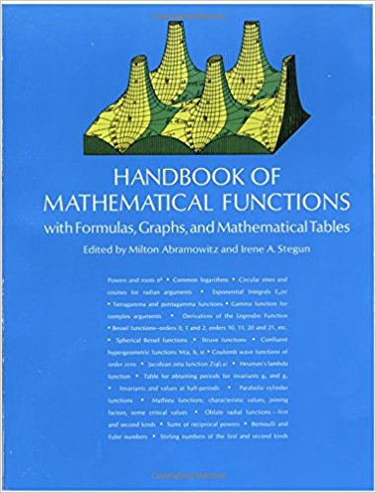
Simulating a Normal Distribution
There are several ways to turn a uniform distribution into a Normal distribution
However, developing an accurate functional approximation to a Normal curve requires advanced mathematics
Consider the following code by Abramowitz & Stegun…
1972

Slide 27
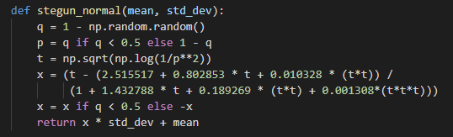
Simulating a Normal Distribution
This was neat, but I did not understand it at all!
Where did all those magic numbers come from?
I was a high school senior – I wanted to base my approach on something tangible

Slide 28
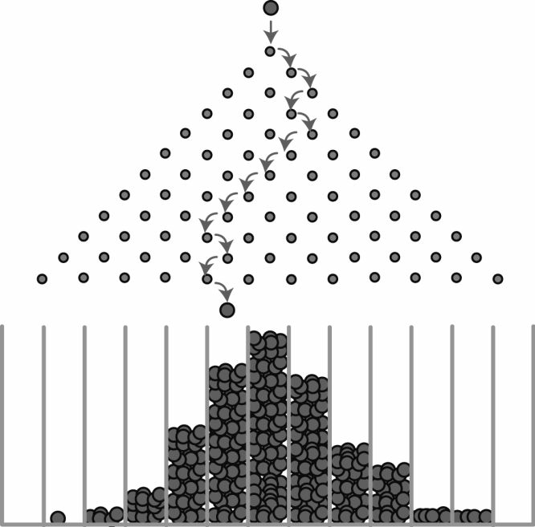
The Pachinko Distribution

Slide 29
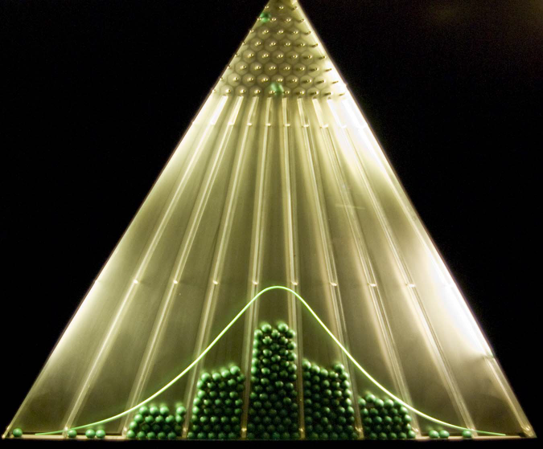
The Pachinko Distribution

Slide 30
Simulating a Normal Distribution
We can simulate dropping balls down a Pachinko machine where at each level a ball can move one step to left or right
If we drop enough balls through enough levels, and we accumulate the count of balls in each slot at the bottom, then we should be able to simulate a normal distribution
We will visually (qualitatively) judge how well this method approximates a Normal distribution
However, there are many statistical (quantitative) methods to calculate if an algorithm emits a distribution that has a reasonable deviation from the perfect (pure) Normal distribution
If the discrepancies are statistically significant, then we cannot trust that our algorithm is producing a “good enough” Normal distribution to use in scientific simulations

Slide 31
Simulating a Pachinko Machine
6 levels
Slot #:

Slide 32
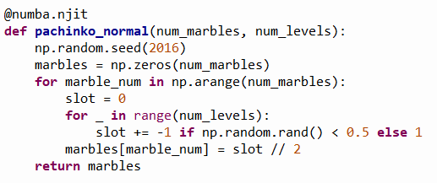
Open pachinko_normal.py
6 levels
Slot #:
-3
-2
-1
0
1
2
3
A "marble" is the slot # (-3 to 3) where it landed
①
②
Python Ternary Operator
③
④
⑤

Slide 33
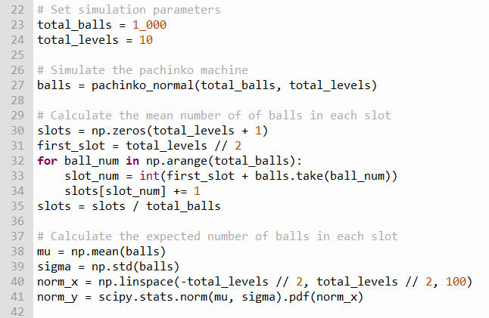
View pachinko_normal.py
①
②
③
④
⑤
⑥
⑦
⑧
⑨

Slide 34
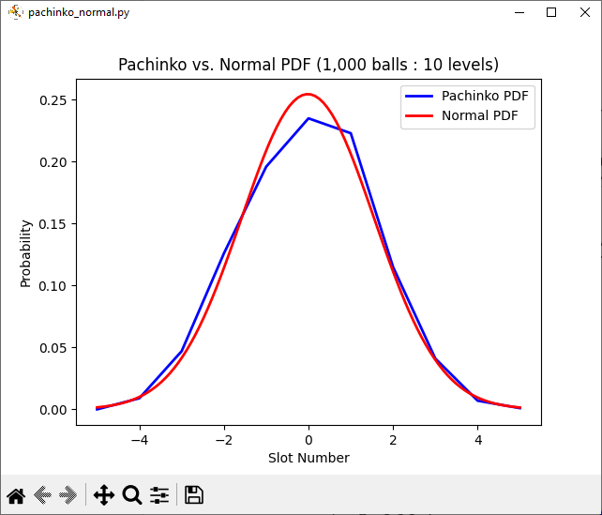
Run pachinko_normal.py
Using these two parameter values does not generate a "good" Normal distribution

Slide 35
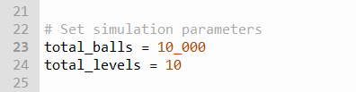
Edit pachinko_normal.py
What if we increase 10x the number of pachinko balls dropped through the machine?

Slide 36
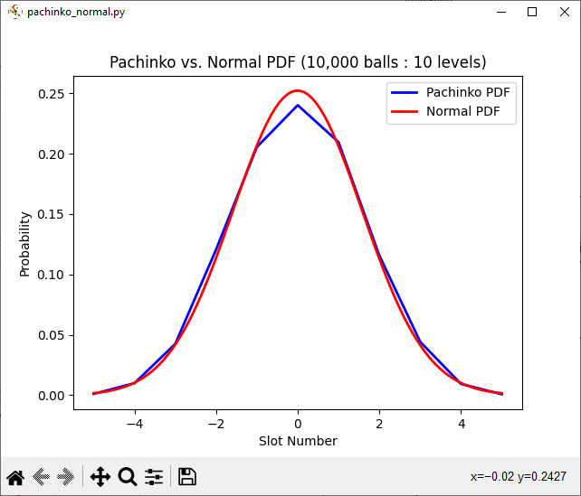
Run pachinko_normal.py
Better, but there are still significant gaps between observed vs. expected values

Slide 37
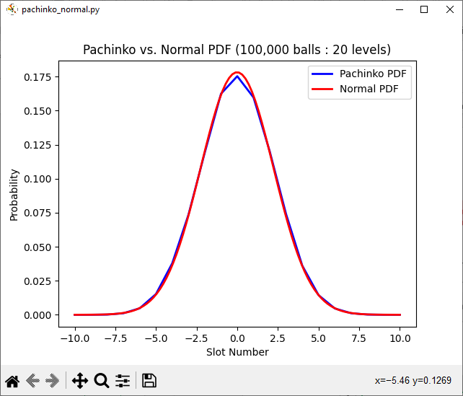
Edit & Run pachinko_normal.py
Increase the number of balls by another 10x
(edit line 23 and set num_balls = 100_000)
Increase the number of levels 2x
(edit line 24 and set num_levels = 20)

Slide 38
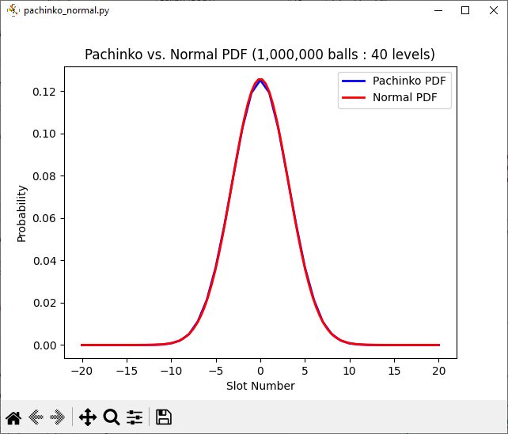
Edit & Run pachinko_normal.py
Increase the number of balls by another 10x
(edit line 23 and set num_balls = 1_000_000)
Increase the number of levels 2x
(edit line 24 and set num_levels = 40)
Still getting some gaps in the slots with the highest probability

Slide 39
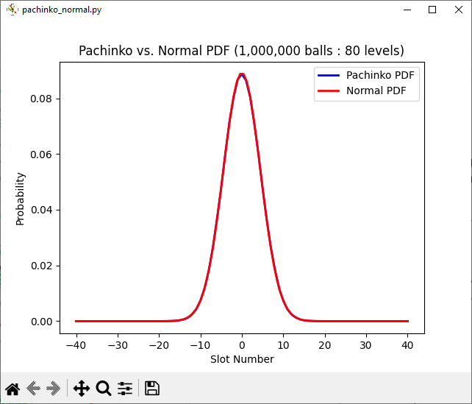
Edit & Run pachinko_normal.py
Finally, around 80 million bounces, we start to faithfully approximate a Normal distribution
Increase the number of levels 2x
(edit line 24 and set num_levels = 80)

Slide 40
Simulating a Normal Distribution
The Pachinko model can accurately mimic a Normal distribution - but only under the right circumstances!
We found that it is not just the number of balls that are used in the experiment that matters, but also the number of levels in the simulated Pachinko board
The levels affect how wide (displacement from the center slot) a ball can fall left or right from the topmost (first) pin
We must use enough levels (therefore creating sufficient width at the last level) to ensure the balls spread out during their fall to occupy those bottom slots that represent the higher sigma values of a Normal distribution

Slide 41
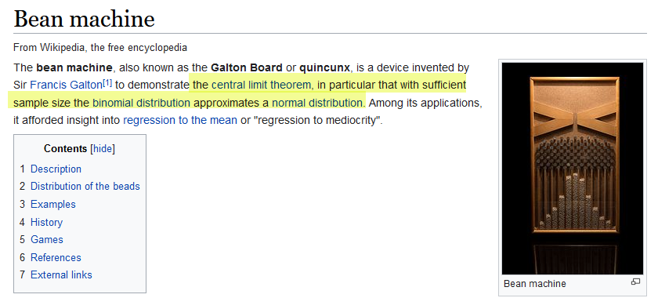
Simulating a Normal Distribution
https://en.wikipedia.org/wiki/Bean_machine

Slide 42
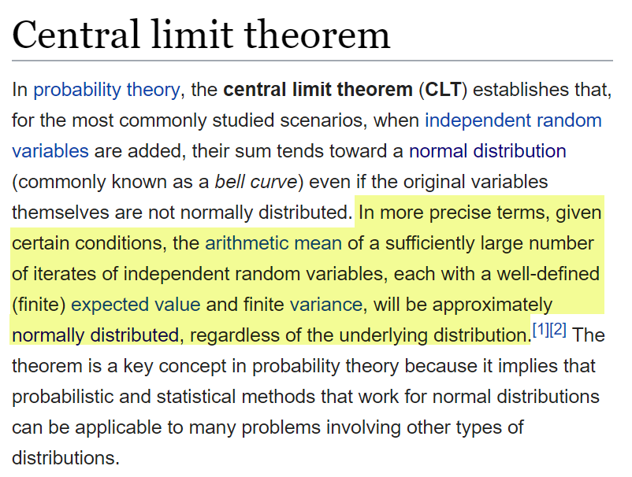
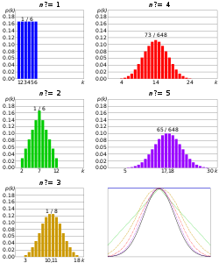
Central Limit Theorem
The Normal distribution (discovered by Gauss) is the most important probability distribution in Science and Engineering!

Slide 43
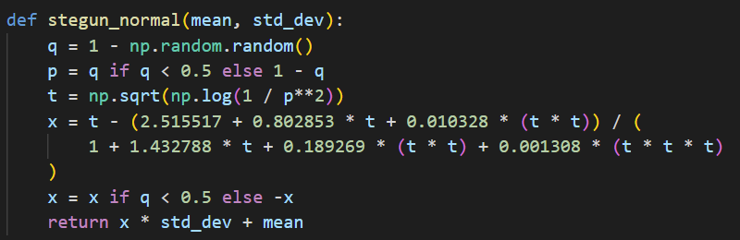
Simulating a Normal Distribution
Python's SciPy.stats uses the code from Abramowitz & Stegun and therefore needs only 1 iteration to generate a normally distributed random variable vs. my Pachinko method which required 80M iterations

Slide 44
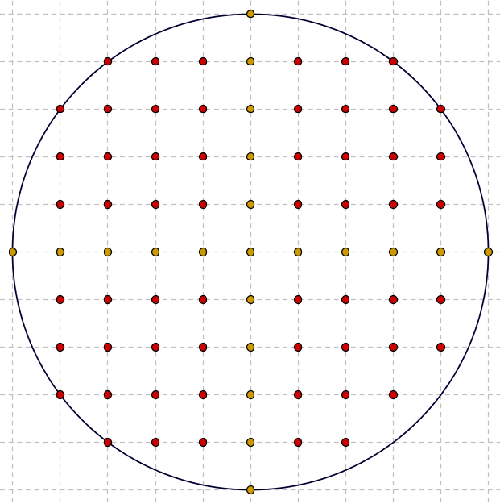
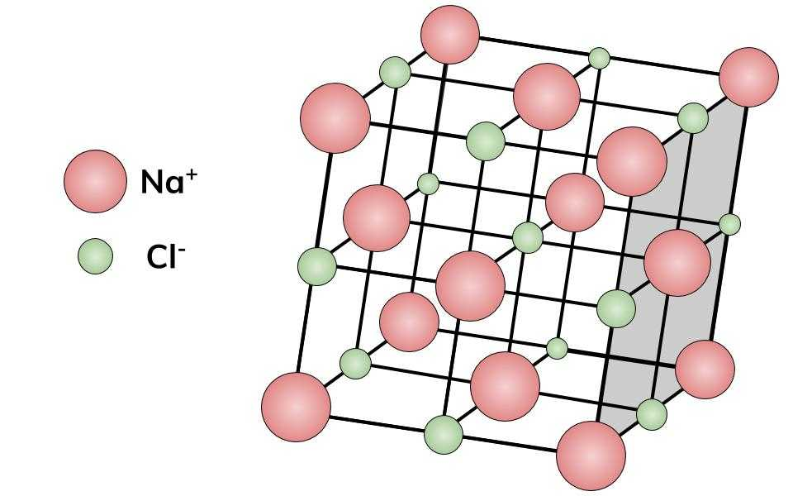
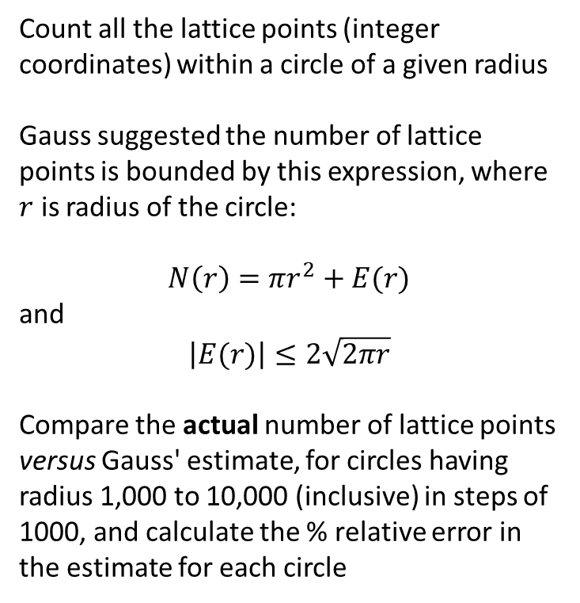
Gauss' Circle Problem
Count all the lattice points (integer coordinates) within a circle of a given radius
Gauss suggested the number of lattice points is bounded by this expression, where $r$ is radius of the circle:
$$N\left(r\right)=πr^{2}+E(r)$$
and
$$\left|E(r)\right|≤2\sqrt{2πr}$$
Compare the actual number of lattice points versus Gauss' estimate, for circles having radius 1,000 to 10,000 (inclusive) in steps of 1000, and calculate the % relative error in the estimate for each circle

Slide 45
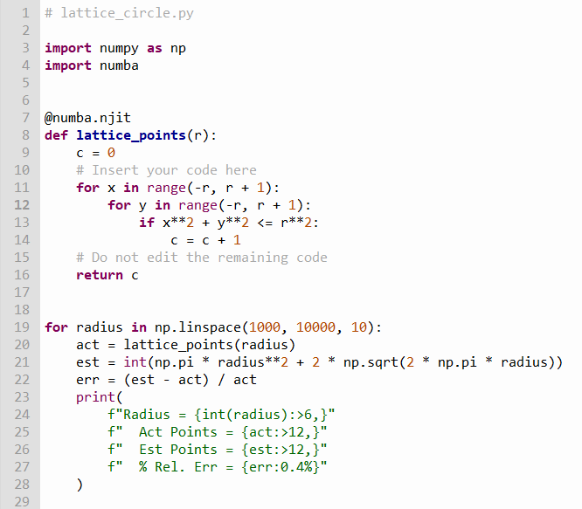
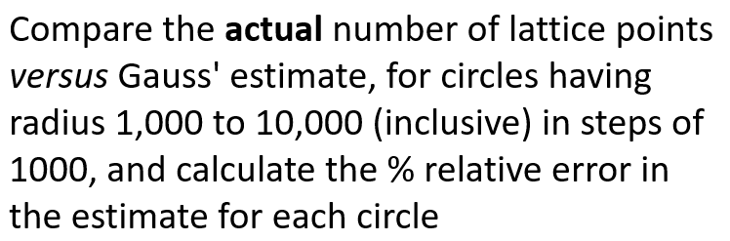
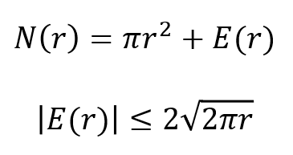
Edit lattice_circle.py
⑥
⑦
⑧
①
②
③
④
⑤

Slide 46
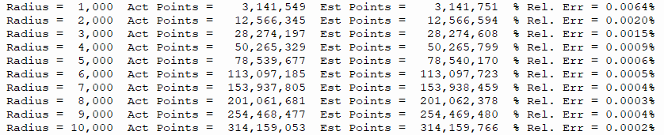
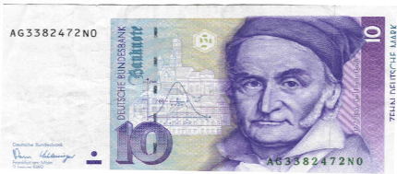
Run lattice_circle.py
Carl Friedrich Gauss
(1777 – 1855)

Slide 47
Session 07 – Know You Know…
The mean of a set is often not enough of a meaningful statistic to describe the shape of the distribution – variance is a measure of central tendency
All random variable distributions have a 1st and 2nd moment which describes the long-term behavior of those random numbers
A perfect Normal distribution ensures that 68.26% of all values fall within one (1) standard deviation from the mean
99.73% of all values in a perfect normal distribution are within three (3) standard deviations from the mean
The normal distribution is known as the “bell curve”

Slide 48

Session 07 – Know You Know…
There are several ways to convert a uniform distribution created by a PRNG into a normal distribution – but don’t use Biersach's Pachinko method ☺
The number of lattice points within a circle leads to another way of calculating $π$ – how is internal area related to the number of "dots" within a figure?
Some statistics are only meaningful after generating an extensive sample set – therefore everything in scientific computing requires big data

Slide 49

Task 07
Update the Python program called maxwell_boltzmann.py to calculate and plot the probability density function (PDF) of the Maxwell-Boltzmann distribution
Using pyplot, all on one graph, display three PDFs using these different parameters: $a=1, a=2, a=5$
Limit the plot domain to $0≤x≤20$
Display a legend to identify each of the three PDF curves
Decorate the graph with an appropriate title and axis labels
Display a grid to identify the $\left(0,0\right)$ origin

